Slide 1
Unit 2
N-Tiered Client/Server Architecture

Slide 2
Introduction
N-tier application architecture provides a model by which developers can create flexible and reusable applications. By segregating an application into tiers, developers acquire the option of modifying or adding a specific layer, instead of reworking the entire application
multi-tier architecture (often referred to as n-tier architecture) is a client–server architecture in which presentation, application processing, and data management functions are physically separated
A three-tier architecture is typically composed of a presentation tier, a domain logic tier, and a data storage tier.
A tier and Layer seems similar but Tier is a Physical Separation where as layer is a Logical separation

Slide 3
Distinct characteristics of C/S
Client-server is a computing architecture which separates a client from a server
It is almost always implemented over a computer network
The most basic type of client-server architecture employs only two types of nodes: clients and servers.
This type of architecture is sometimes referred to as two-tier.
It allows devices to share files and resources.
Server provides the service
Client is considered as the customer requesting the service
The server service can be shared among a number of clients
Clients must request or initiate the service
The location of the server in the network is transparent to clients
Transaction between C/S is message-passing based
C/S architecture is scalable
horizontally (more clients can added)
Vertically (more servers can be added)
The server is centrally maintained where as clients are independent of each other

Slide 4
Significance of “Tiers”
N-tier architectures have the same components
Presentation Layer
Business/Logic Layer
Data Layer
N-tier architectures try to separate the components into different tiers/layers
Tier: physical separation
Layer: logical separation

Slide 5
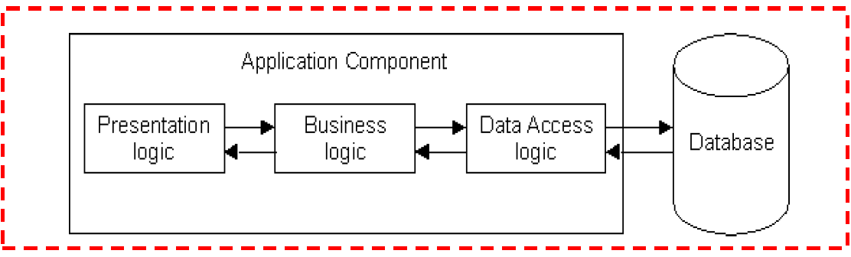
1-Tier Architecture
All 3 layers are on the same machine
All code and processing kept on a single machine
Presentation, Logic, Data layers are tightly connected
Scalability: Single processor means hard to increase volume of processing
Portability: Moving to a new machine may mean rewriting everything
Maintenance: Changing one layer requires changing other layers

Slide 6
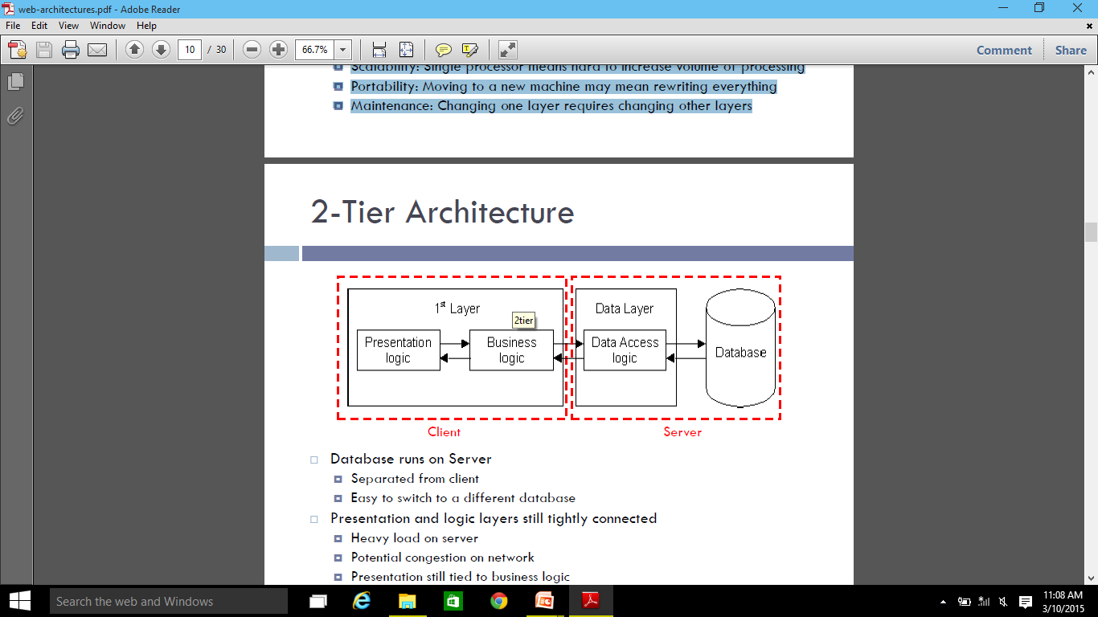
2-Tier Architecture
Database runs on Server
Separated from client
Easy to switch to a different database
Presentation and logic layers still tightly connected
Heavy load on server
Potential congestion on network
Presentation still tied to business logic

Slide 7
Contd..
Fat Client Model:
The client side becomes more and more fat for increase in complexity of applications there by reducing the effective bandwidth of the network.
This system combines the presentation layer and business logic layer where in the data access layer is a separate tier
Fat Server Model:
In this system the stored procedure is placed with in the database. So whenever the business logic changes, the procedure must be modified. Thus the server side is fatter in this system.
Development of stored procedure, which enhances portability, is an improvement in this system though does not solve most of the problem of Fat Client Model.

Slide 8
Disadvantage of 2-Tier Architecture
Network performance suffers reducing the amount of bandwidth of other users.
Changing business logic layer involves recompiling and redeploying the client tier.
Fat client are bound to database API such as relational databases. This involves not only redeploying each client but the client code should also change to suit the new database type.
Every client needs to establish its own database connection. Therefore, database connection costs are high
Database drivers must be installed and configured on each of the client tiers, which include high deployment cost

Slide 9
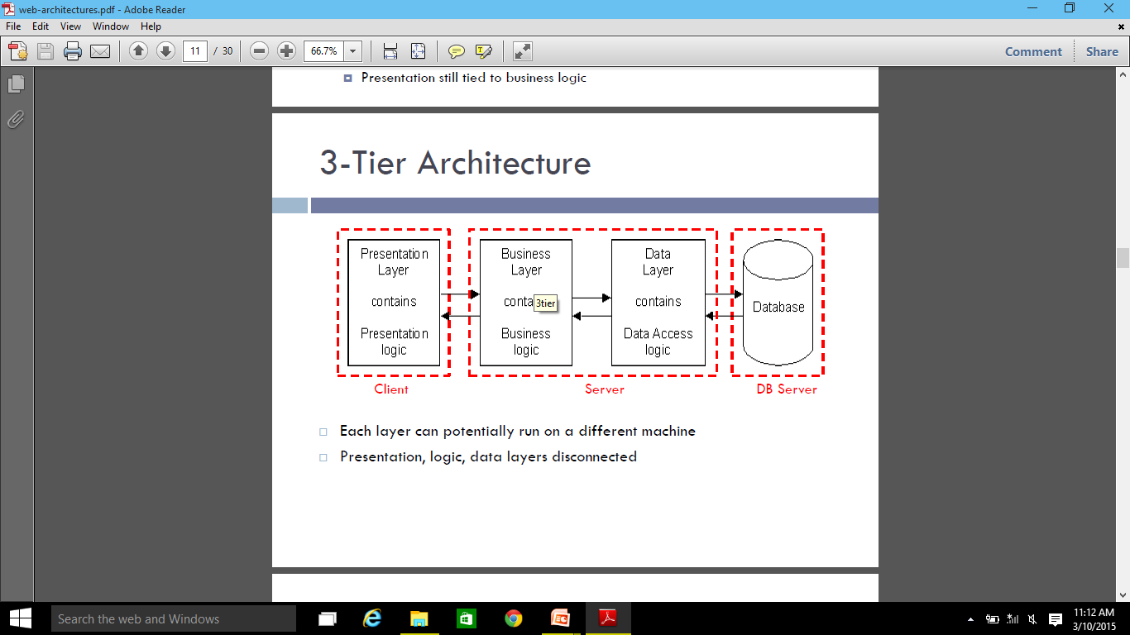
3-Tier Architecture
Each layer can potentially run on a different machine
Presentation, logic, data layers disconnected

Slide 10
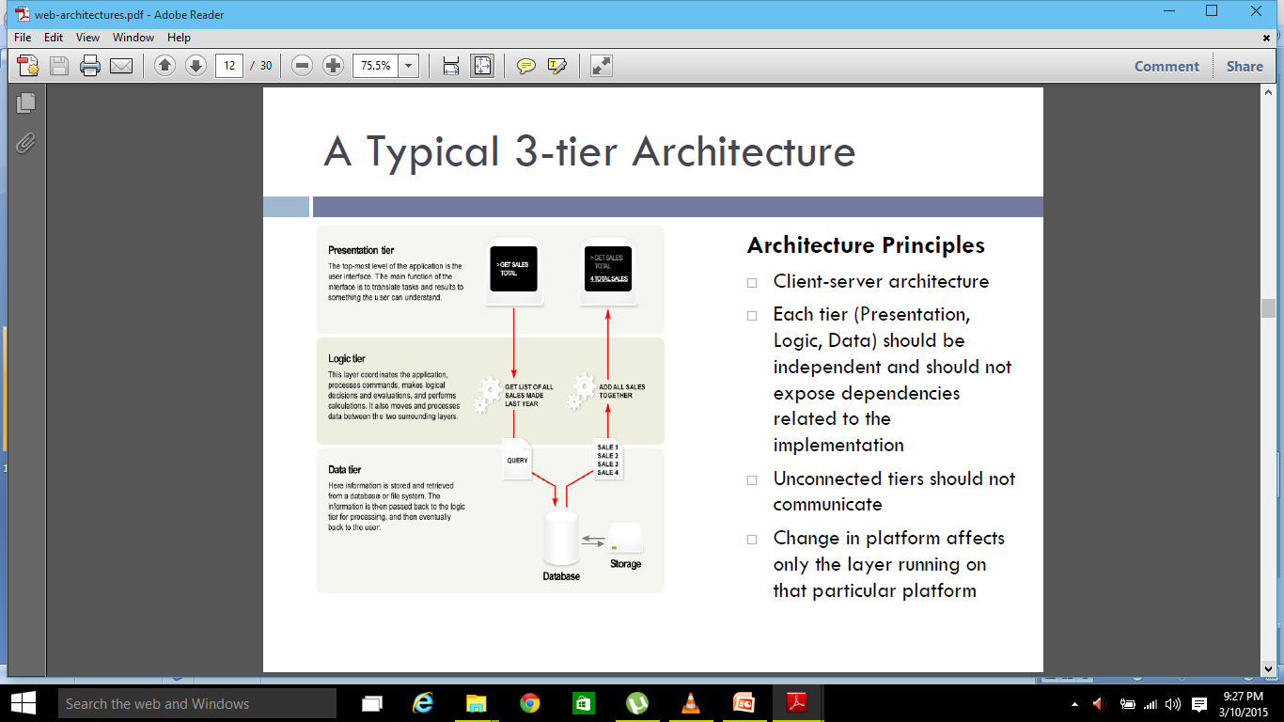
3-tier Architecture Overview
Architecture Principles
Client-server architecture
Each tier (Presentation, Logic, Data) should be independent and should not expose dependencies related to the implementation
Unconnected tiers should not communicate
Change in platform affects only the layer running on that particular platform

Slide 11
3-tier Architecture Overview
Presentation Layer
Provides user interface
Handles the interaction with the user
Sometimes called the GUI or client view or front-end
Should not contain business logic or data access code
Logic Layer
The set of rules for processing information
Can accommodate many users
Sometimes called middleware/ back-end
Should not contain presentation or data access code
Data Layer
The physical storage layer for data persistence
Manages access to DB or file system
Sometimes called back-end
Should not contain presentation or business logic code

Slide 12
The 3-Tier Architecture for Web Apps
Presentation Layer
Static or dynamically generated content rendered by the browser (front-end)
Logic Layer
A dynamic content processing and generation level application server, e.g., Java EE, ASP.NET, PHP, ColdFusion platform (middleware)
Data Layer
A database, comprising both data sets and the database management system or RDBMS software that manages and provides access to the data (back-end)

Slide 13
3-Tier Architecture - Advantages
Independence of Layers
Easier to maintain
Components are reusable
Faster development (division of work)
Web designer does presentation
Software engineer does logic
DB admin does data model
Complex application rules easy to implement in application server
Business logic off-loaded from database server and client, which improves performance
Changes to business logic automatically enforced by server – changes require only new application server software to be installed
Application server logic is portable to other database server platforms by virtue of the application software
Superior performance for medium to high volume environments

Slide 14
Disadvantage
More complex structure
More difficult to setup and maintain
The physical separation of application servers containing business logic functions and database servers containing databases may moderately affect performance.

Slide 15
Middleware
Middleware refers to the software which is common to multiple applications and builds on the network transport services to enable ready development of new applications and network services.
Middleware typically includes a set of components such as resources and services that can be utilized by applications either individually or in various subsets.
Examples of services: Security, Directory and naming, end-to-end quality of service, support for mobile code.
Examples:
OMG’s CORBA
J2EE - Java 2 Enterprise Edition
Microsoft’s .Net

Slide 16
Middleware features
Allows communication
through a standard language
across different platforms
between legacy and modern applications
Takes care of
transactions between servers
data conversion
authentication
communications between computers
Provides runtime environment for components in the middle-tier
Component lifecyle and management
Transaction, event and security services
Provides connections to databases, mainframes and legacy systems
Separates client-tier from the data source
Clean separation of user-interfaces and presentation logic from the data source

Slide 17
Multi-Tier Architecture
The front end component is responsible for providing portable presentation logic.
The back end component acts as database server.
The middle tier component allows the user to share control business logic by isolating it from actual application.
This system is Fat in the middle.
The middle tier through a standard protocol such as http or RPC.
The middle tier interact with back end server through standard database protocol such as SQL, ODBC and JDBC

Slide 18
N-Tier Architecture
N tier architecture means splitting up the system into N tiers, where N is a number from 1 and up
With four or more tiers, each layer can be further decomposed to allow various parts of the system to scale independently.
More sophisticated multi-tier solutions appear in this model.
This architecture leads to reduction of network traffic, faster network communications, greater reliability and greater overall performance

Slide 19
Benefits of N-Tier Architecture
Database drivers are installed and configured on the server-side, rather than on client machines. Hence deployment costs are low.
Data base switching costs are low: There is a middle tier for data access. This enables the users to migrate database schemas, or change the different database drivers without redeploying the clients.
Changing the business logic layer may not necessitate the redeploying the client tier.
By placing a firewall between the presentation and business logic tiers, high security can be provided to the data easily.
Rather than, the business components acquiring and releasing connections to the resources such as databases, the resources can be pooled and reused for different client requests. Resource pooling can also be applied to other resources such as threads and socket connections. Business components themselves can be pooled by multiple clients.
Since there are many tiers and each tier is independent, the database images can be added while minimizing the changes and recompiling other tiers.
If one tier is overloaded, other tier can still function properly there by improving the performance.
If critical error occurs, it is localized to a single tier

Slide 20
Disadvantages and Application of N-tier Architecture
Since the tiers are physically separate, they must communicate across the process boundaries, machine boundaries or enterprise domain boundaries. This results in high communications overhead.
Software installation costs, software upgrade costs and other administration costs are high.
Application of N-Tier Architecture:
It plays a major role in internet and intranet services, transaction processing monitors, distributed computing and most other growing software technologies.
N-Tier provides a wide range of benefits to the companies longing for flexible and reliable solution to complex, and constantly changing problems. It also provides information and tools to solve some of the challenges faced by IT professionals

